Slide 1


IEEE Internet of Things (IoT) Initiative
Name, Title
Date
iot.ieee.org

Slide 2
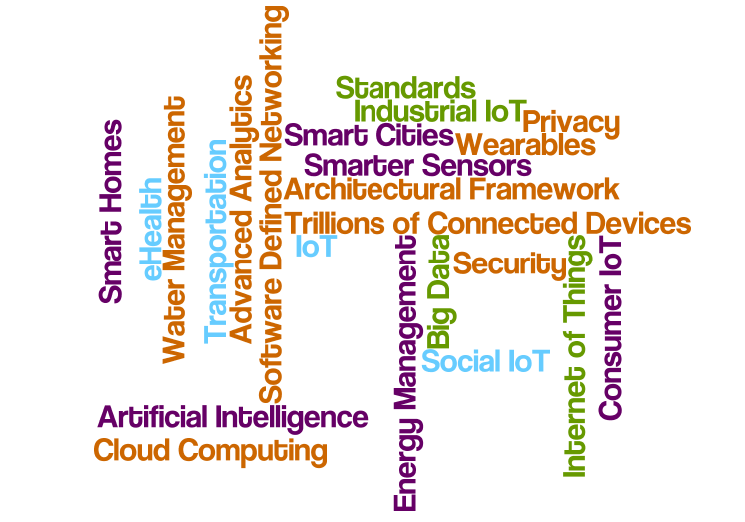
The Global Internet of Things
Be part of the sweeping convergence of technologies, markets, applications, and the Internet through the IEEE Future Directions Internet of Things (IoT) Initiative

Slide 3
IEEE IoT: A Collaborative Gathering Place for Technologists
The mission of the IEEE IoT Initiative is to serve as the gathering place for the global technical community working on IoT; to provide the platform where IoT professionals learn, share knowledge, and collaborate on this sweeping convergence of technologies, markets, applications, and the Internet, and together change the world.

Slide 4
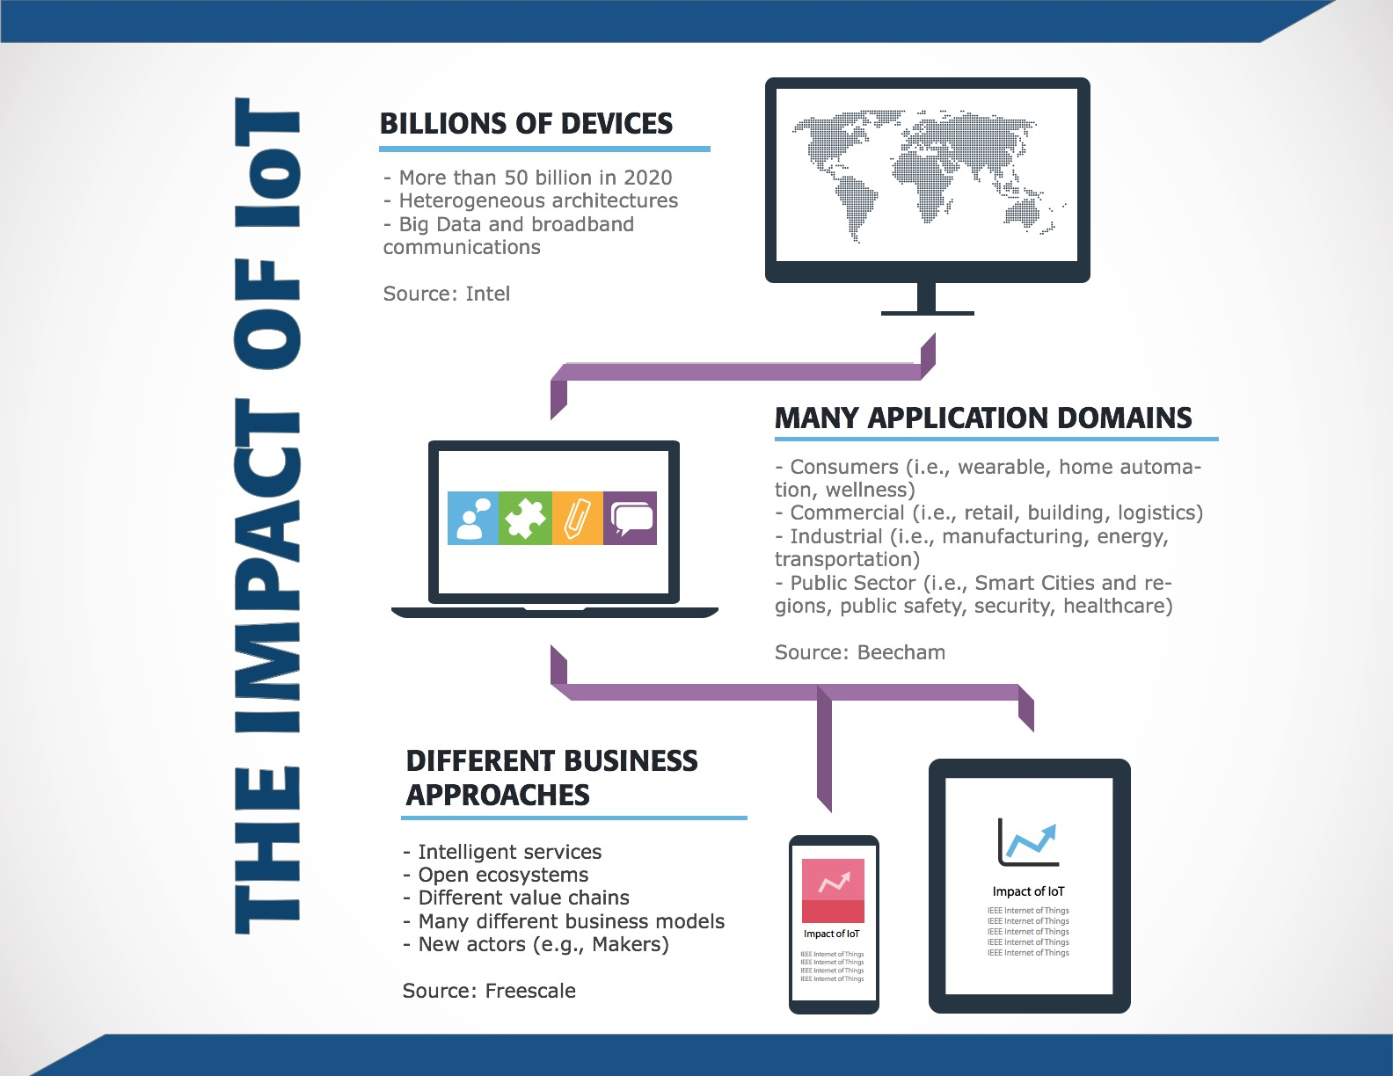

Slide 5


The IoT is Driving Markets
  Connected-home device shipments
  will grow at a compound annual rate of
  67% over the next five years..and hit
  1.8 billion units shipped in 2019 –
  BI Intelligence
IoT-connected wind and solar installations
will grow at a CAGR of 21% from 2014 -2020
with total number of connections growing
from almost two million in 2014 to 6.3 million
in 2020 - ABI Research

Slide 6
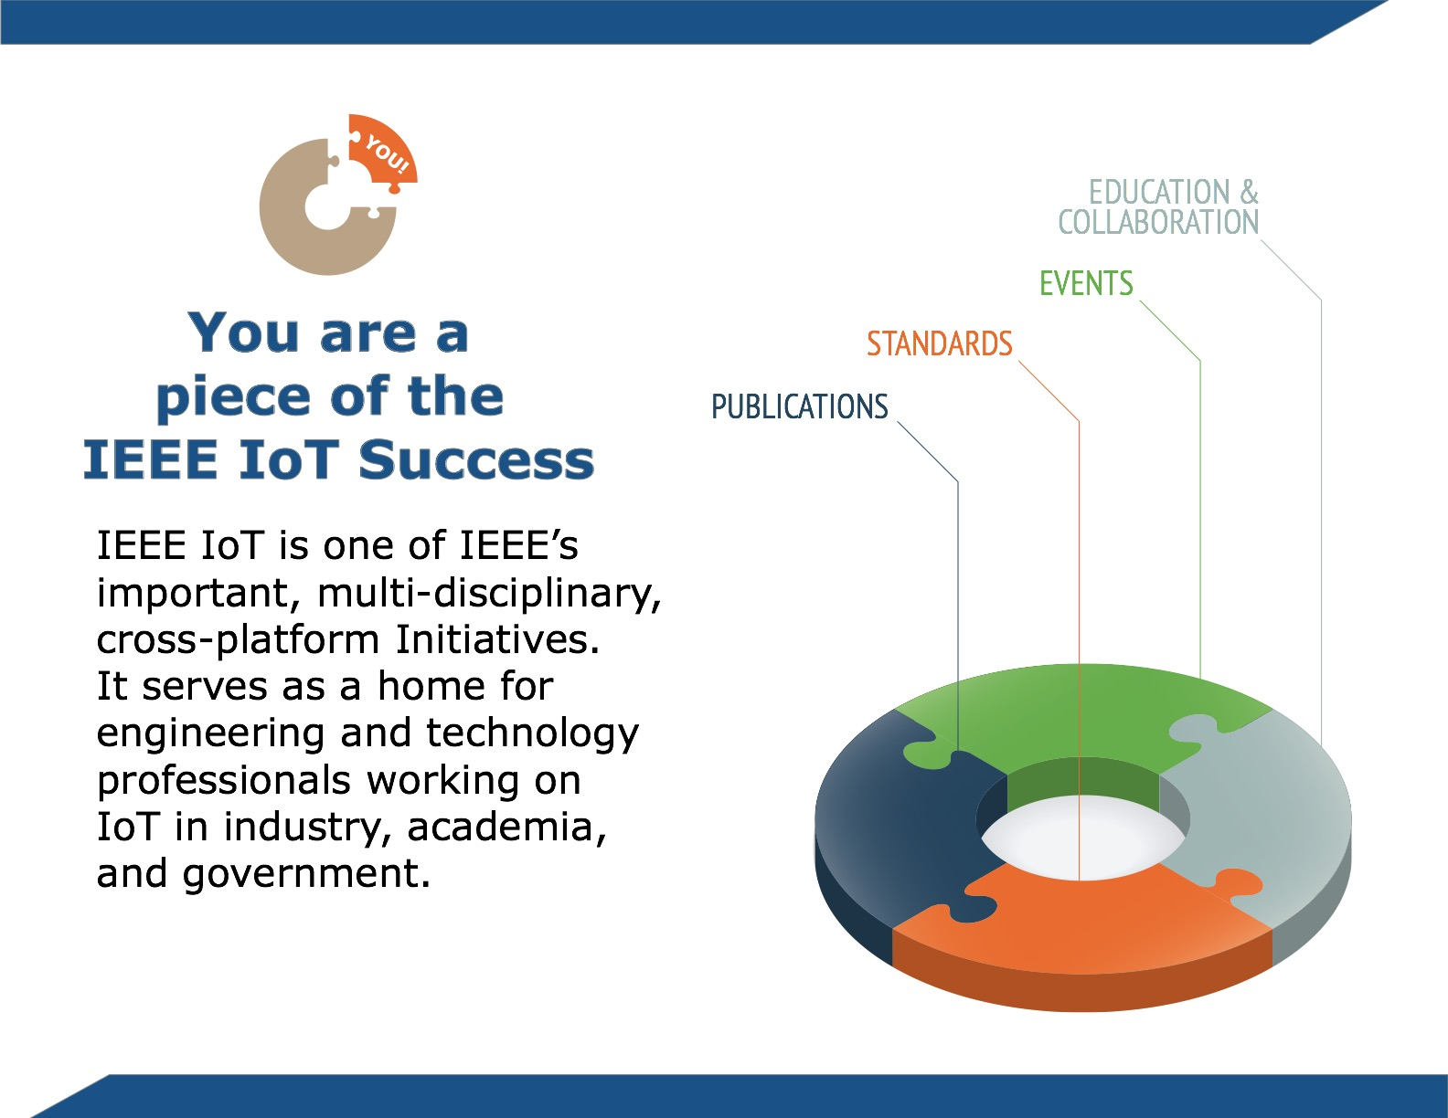
Notes:
Prior to the launch of the IoT Initiative, IEEE IoT activities and offerings were siloed; making it a challenge for members and non-members seeking a “one-stop-shop” for globally-relevant IoT intelligence and to navigate and connect the dots
The activities that comprise the IEEE IoT Initiative provide a global view and a platform for ideas exchange and knowledge

Slide 7


The IEEE IoT Initiative
    Brings people together
    Is a thought leader essential to the IoT community
    Enables discussion
    and engagement
    amongst the broad
    span of IoT disciplines
Notes:
02/08/10
7

Slide 8
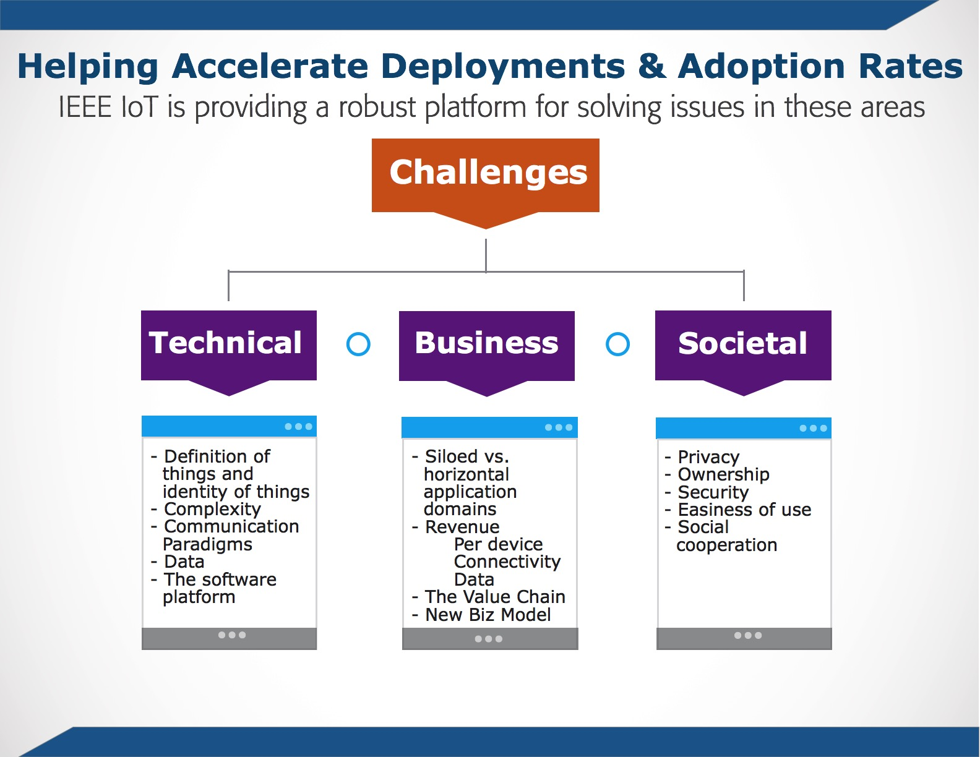

Slide 9
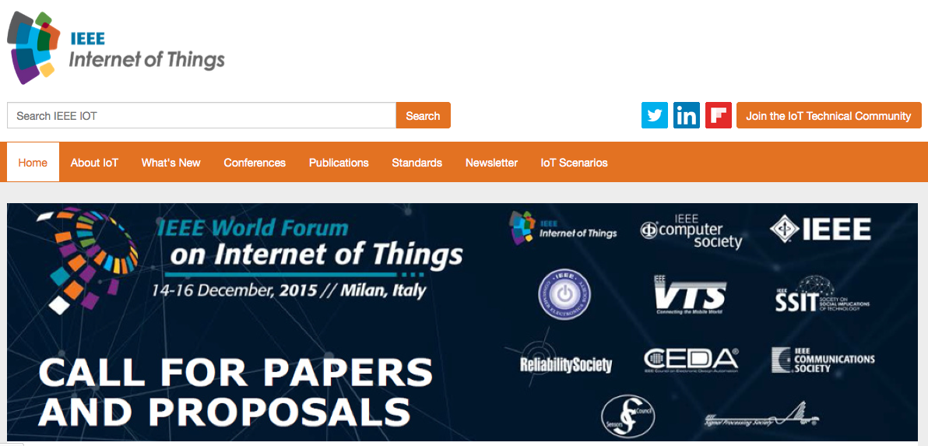
Thought Leadership: IEEE IoT Web Portal
9
Learn, Talk, Contribute, Share
Integrated gateway to IoT intelligence, education, news from IEEE experts and other expert sources
Essential resource for anyone involved in IoT
Educational Videos
IEEE Talks IoT Q&A series with IoT Experts
IoT Webinars
Insightful Articles
Conferences and Events
IoT Standards
IoT.IEEE.org

Slide 10
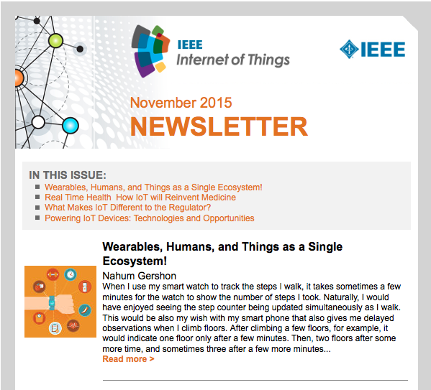
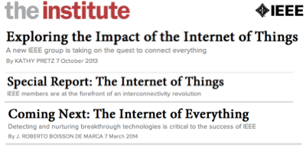
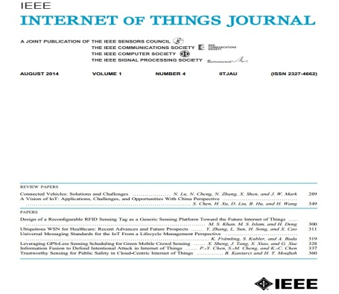

IEEE IoT Thought Leadership: Newsletter & Publications
IEEE IoT Newsletter
Bi-monthly, technically focused electronic publication highlighting important IoT-related technology developments, innovations, and trends from the world’s top subject matter experts, researchers, and practitioners
The Institute Special Report: The Internet of Things, March 2014
  Internet of Things Journal
  11 issues; 94papers

Slide 11







IEEE IoT Experts Webinar Series
Learn from recognized industry experts about critical aspects of the IoT ecosystem.
IEEE IoT experts are available to speak, answer questions, and connect interested professionals to the world of IEEE IoT.
Roberto Saracco, President, EIT ICT LABS Italy and Italy Node Director European Institute of Innovation and Technology; senior member IEEE; chair IEEE Future Directions Committee
Roberto Minerva, head of Innovative Architectures, Future Centre, Strategy Department, Telecom Italia; chair IEEE Future Directions Committee Working Group
Dr. Chung-Sheng Li, Director, Commercial Systems Department, PI IBM Research Cloud Initiatives, executive sponsor, Security 2.0 strategic initiative, IBM T.J. Watson Research Center; IEEE Fellow
Oleg Logvinov, Chair, IEEE P2413 Working Group, Architectural Framework for IoT ; Director, Special Assignments, STMicroelectronics' Industrial & Power Conversion Division
Dr. Chuck Adams, President, IEEE Standards Association (IEEE-SA) 2009-2010; BoD IEEE-SA; founding member IEEE IoT development program; Distinguished Standards Strategist Huawei Technologies
YK Chen, IEEE Fellow; Principal Researcher, Intel Corporation; Associate Director Intel-National Taiwan University Connected Contest Computing Center
Antonio Manzalini, Senior Manager, Strategy & Innovation, Future Centre - Telecom Italia; IEEE member; chair, IEEE Software Defined Networks Initiative

Slide 12
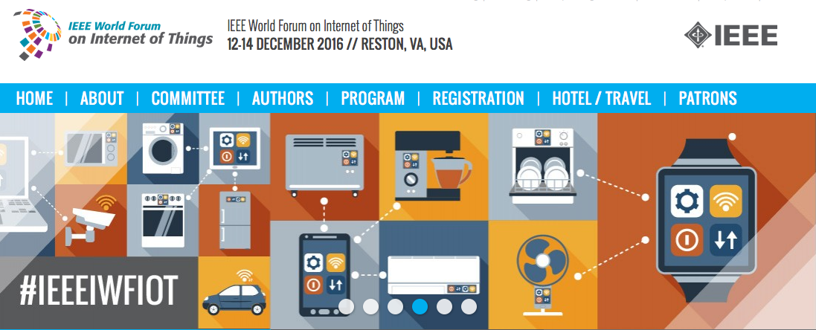
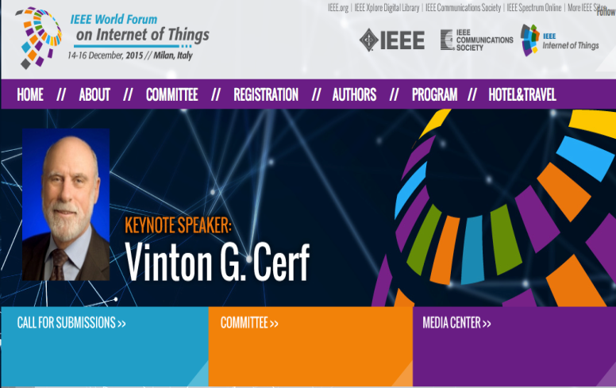

IEEE IoT Brings People Together: Events
12
IEEE World Forum on IoT Conference 2016
12-14 December 2016
Reston, VA, USA
http://www.ieee-wf-iot.org/
IEEE World Forum on IoT Conference 2015
14-16 December 2015; Milan, Italy
400 registrants from 40 different countries
http://wfiot2015.ieee-wf-iot.org/
IEEE World Forum on IoT Conference 2014
Inaugural event March 2014; Seoul, South Korea
237 attendees; Representation from 60+ global organizations

Slide 13
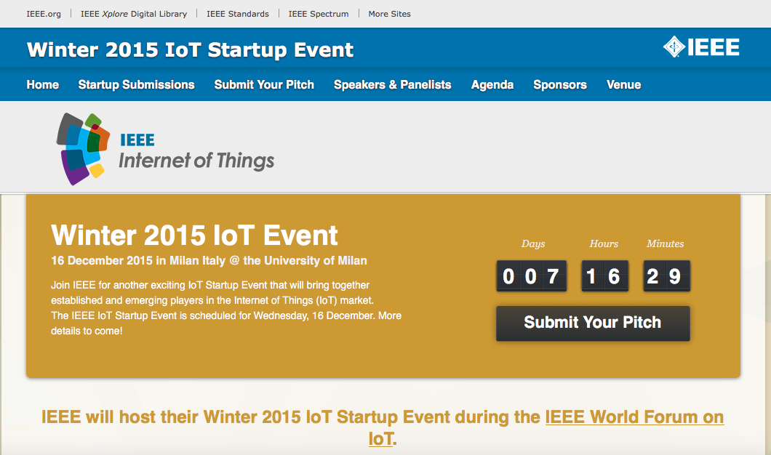


IEEE IoT brings people together: Events
13
IEEE IoT Soiree & Startup Events
Bringing together established and emerging players in IoT. Fostering IoT innovation. A catalyst for expansion and growth of the IoT ecosystem
Startup “Hot Seat”: Startup companies introduce themselves to potential partners and investors
  January 2016, Consumer Electronics Show, Las Vegas, USA
  December 2015, WF-IoT 2015, Milan, Italy
  December 2015, New York City, USA
  November 2015, IoT Planet, Grenoble, France
  August 2015, Tel Aviv, Israel
  May 2015, San Jose, CA, USA
  January 2015, Consumer Electronics Show, Las Vegas, US
IEEE IoT Workshops
Global IoT experts, leaders, and other participants explore
new technologies, IEEE standards, applications, and future business models
September 2014, Silicon Valley
April 2013, Shenzen, China
November 2013, Silicon Valley
November 2012, Milan, Italy

Slide 14

IEEE IoT Enables Discussion & Engagement: IoT Use Cases
A collaborative space for IoT Scenarios & Use Cases
http://iot.ieee.org/iot-scenarios.html

Slide 15
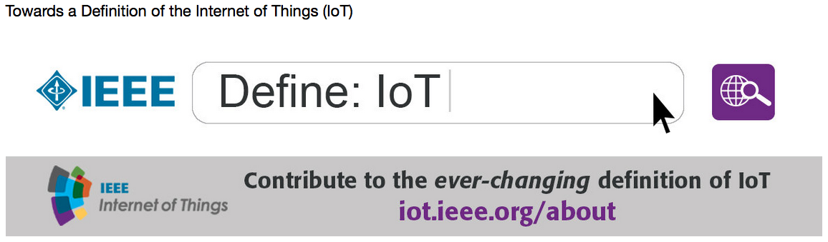
Turn to IEEE IoT for Content, Knowledge, Standards, Collaboration
The Internet of Things (IoT) Definitions Document
A “living document” in a collaborative space on the IEEE IoT web portal
Baseline definitions of IoT
Gain and contribute knowledge and ideas
Lead to further research
Advance understanding of IoT
Get involved in the universal discourse underway now!
http://iot.ieee.org/definition.html

Slide 16
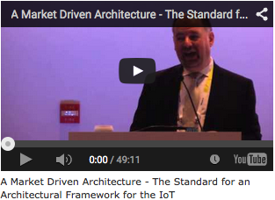

Creating an Ecosystem Through Standards: IEEE P2413
16
This draft standard defines an architectural framework for the Internet of Things, including descriptions of various IoT domains, definitions of IoT domain abstractions, and identification of commonalities between different IoT domains.

Slide 17




IEEE Enables Discussion: Diverse IoT Community
17
IEEE
  More than 426,000 members in more than 160 countries, more than 50 percent of whom are fromo utside the United States
IEEE IoT Technical Community
  ~10,000* members and growing
  Join today via iot.ieee.org
IEEE IoT on Twitter
  Top-Tier Voice and resource in social media
  Large community of meaningful followers
  YTD reach: 111M impressions**
LinkedIn Group: IEEE Internet of Things
  Connect with thousands of senior-level and engineering community members interested in IoT
  Join: https://www.linkedin.com/grp/home?gid=5148323
Flipboard: IEEE Internet of Things
  14,000+* Viewers | ~1,500* Followers, 3,500+* Articles
  Follow us via https://flipboard.com/@stogner/ieee-internet-of-things-rsqdr8ty
* As of March 2015 ** As of November, 2015

Slide 18
18
IEEE IOT Initiative Organization
Chair
(R. Minerva)
Industry Engagement Track
(O. Logvinov)
Conferences Track
(V. Piuri)
Standards Track
(C. Adams)
Publications Track
(Y.K. Chen)
Content / Community Dev. Track
(L. Stogner)
Scenarios
Track
(H. Berndt)
Education Track
(A. Pears)
Education Working Group
Publications Working Group
Ind. Engag. Working Group
Conferences Working Group
Standards Working Group
Content / Cmmty Dev. Working Group
Scenarios Working Group
Staff Program Director
(H.Tepper)
Staff FDC
Sr. Director
(W. Tonti)
Notes:
02/08/10
18

Slide 19


Engage With IEEE in IoT Today!
The IEEE:
  www.ieee.org
IEEE Internet of Things (IoT) Initiative:
  iot.ieee.org
IEEE Standards Association (IEEE-SA) – Internet of Things:
  standards.ieee.org/innovate/iot
  IEEE Xplore Digital Library:
  ieeexplore.ieee.org/Xplore/home.jsp
19

Slide 20

iot.ieee.org

